Slide 1
Intro to AI for Medicine
Lec 6: Network

Slide 2
Last Time:
Discussed different ways of encoding data so it can interface with matrices
Went over types of bias
Introduced data augmentation

Slide 3
Before
Learned what the structure of the regular neural net looks like

Slide 4
Today
Variations on the theme of the regular neural net, and how that can help solve a wider class of problems
Everything we’ll see today is just a small but creative tweak to the network we already know!
Each tweak addresses a key limitation with the original NN for fitting different problems

Slide 5
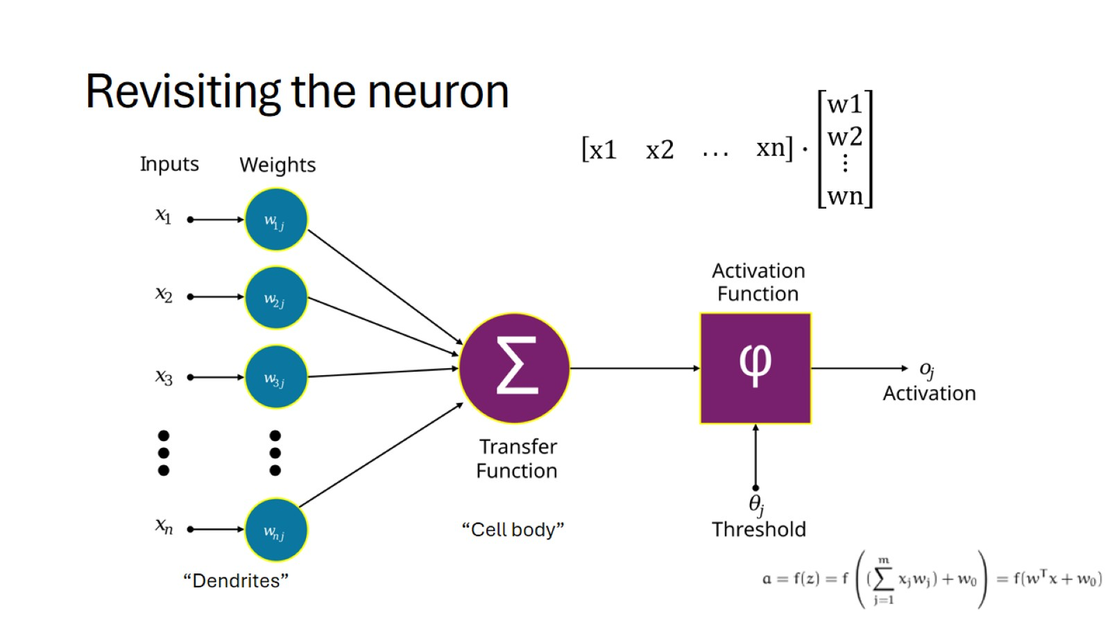
Revisiting the neuron
Notes:
Go back thru it
Before, we considered hyperparameters which force us toward a certain kind of output

Slide 6
Inductive Bias
Not bias in the traditional sense – it’s the direction we point our model toward via the construction of the network
Ex. For linear regression (no neural net) we assume our data can be fit linearly
For other problems, we can give our ML model a hint by changing the way it processes data
Notes:
So if we know something about our data and what our output should take into account and look like, we can change our network accordingly

Slide 7
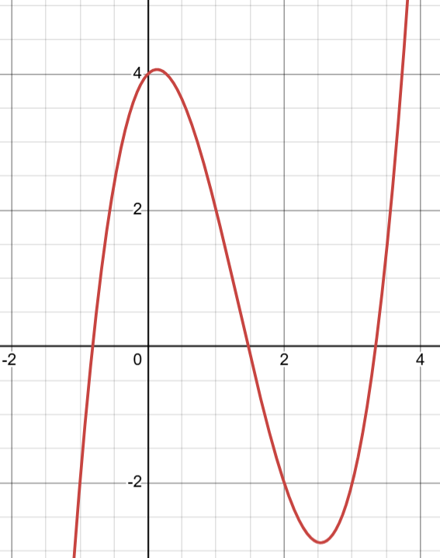
Examples of Inductive Bias
Smoothness: Similar inputs have similar outputs
Notes:
If you have one point, if you go .0001 to the side it’s not going to be one million higher and then another .0001 right back
Neural nets have this assumption

Slide 8
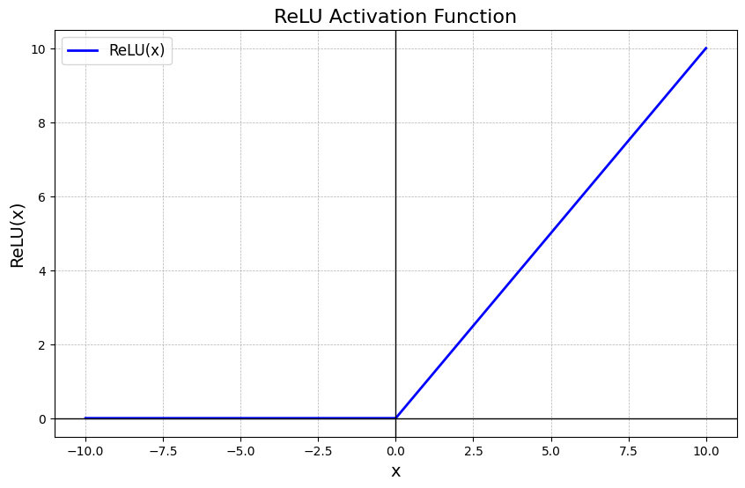
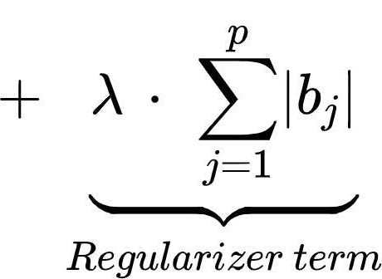
Examples of Inductive Bias
Sparsity: Your question can be answered by only a few key inputs
In other words: not every input matters for every question
Notes:
Medically: If a patient comes in with a broken leg, you don’t need to be looking at their immunoglobulins to determine the best course of treatment
Relu: many outputs are set to 0 if they end up in the negative
Lasso regularization: the bigger the weights are the bigger the penalty – so many go to zero

Slide 9
Inductive Bias
No free lunch rule: If your inductive bias works well for one type of data, it works worse for another type.

Slide 10
Can We:
Incorporate time?
Extract only the most key information, removing noise?
Our outputs want to be as similar to a known dataset as possible?
Consider spatial relationships in imaging?
Recurrent Neural Nets
Autoencoders
Generative Adversarial Nets
Convolutional Nets
Notes:
Our model could learn that time plays a role… but that would be hard
Key info – that’s the sparsity thing. Can we build it into the network itself?

Slide 11
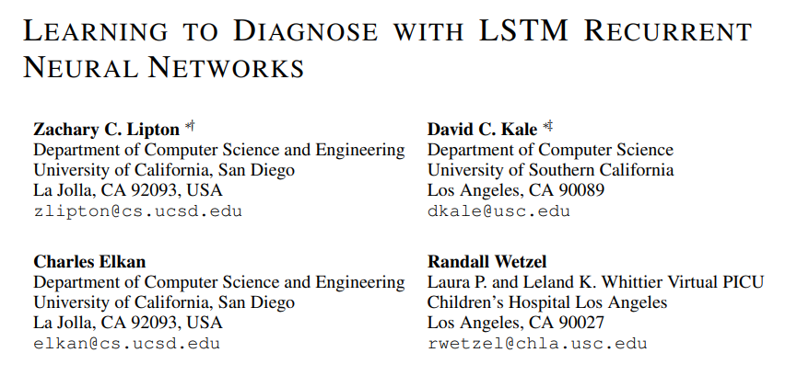
Example Case
Chart data for patients in the PICU
Every day, we get a new set of labs
Every few hours, we get new vitals
Can we use not only the data, but the change in the data to accurately diagnose?

Slide 12
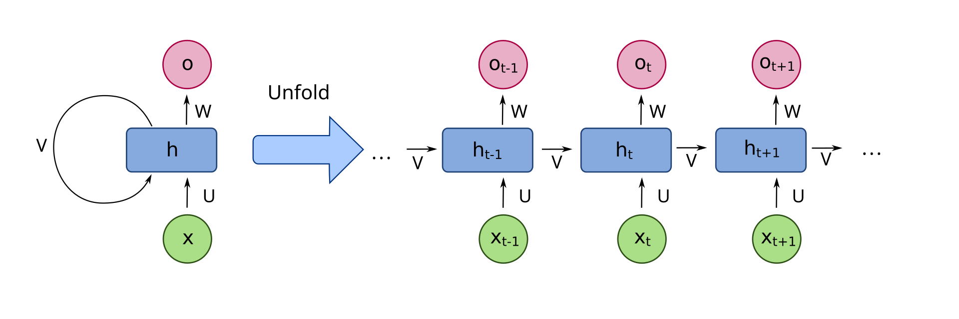
Recurrent Neural Nets
Idea: Capture effect time has on data by combining new input with current state.
How it’s implemented: “looped” neural net which receives data from input at a given time and the current state

Slide 13
Recurrent Neural Nets
Notes:
At each time step, we take in an input x. Think of this as the new updates that have happened.
At the same time, we take in v, which is the current state

Slide 14
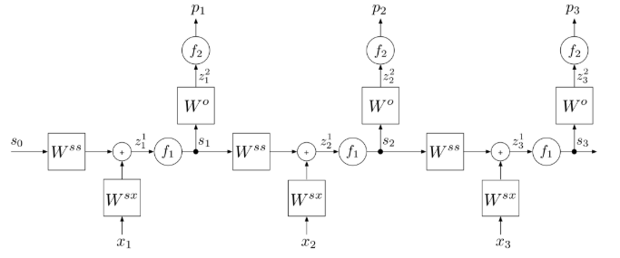
Recurrent Neural Nets
Notes:
At every level, we have an input, state and prediction.
Because it can be unrolled we can do backpropagation on it.

Slide 15
Recurrent Neural Net: Formalization and Loss
Let’s say we want to predict a sequence.
We have pairs of x_{t} and y_{t} for a given time step.
So for a given sequence of inputs, we want a certain sequence of outputs
Loss function is loosely defined – can be anything that measures similarity between predictions and actual, summed across timesteps

Slide 16
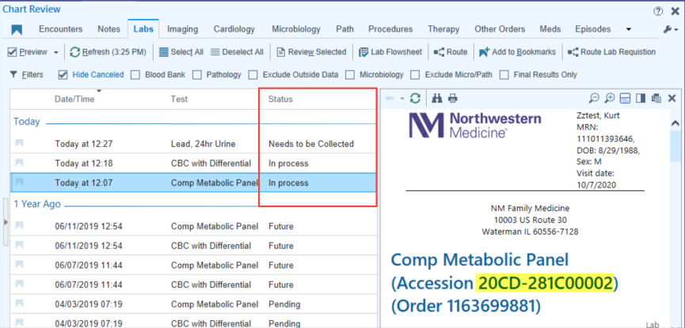
RNN: Inductive Bias
Data has a temporal relationship
Last state has a large effect on what the next state will be (recency bias)
Notes:
Another version of the smoothness IB
If data shuffled, IE pt labs where order means nothing, then performance will be hurt.

Slide 17
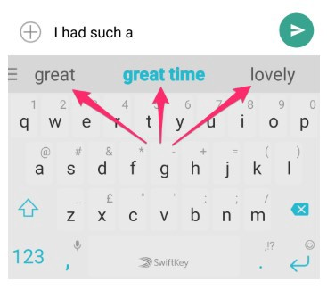
RNN: Character Prediction
Let’s say we have a sequence of characters and want to predict the next

Slide 18
General Problem Statement
Technical Problem Statement
Data | Loss
Network | Training
Predict the next word the user wants to type
Multiclass classification of sequential data – finding the most likely
A ton of user text messages
Multiclass log loss at each step, summed across network
RNN
Simple for now
Notes:
Loss: 1 for whatever the word is, 0 for everything else, but remember we have many examples.

Slide 19
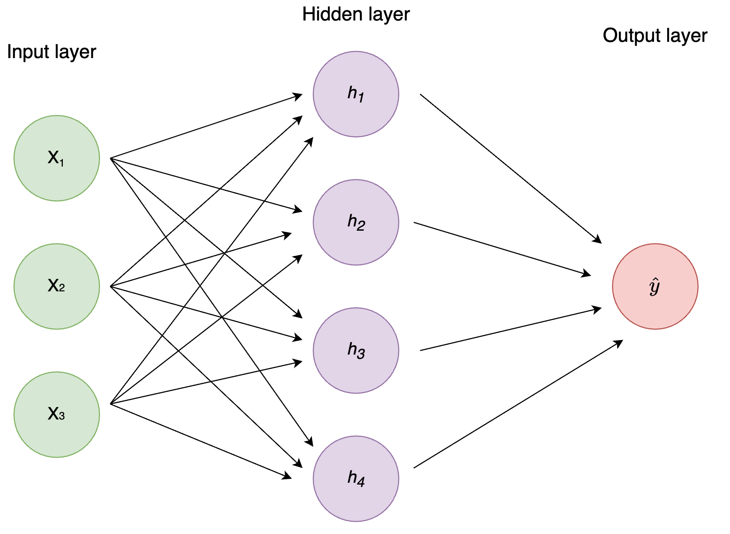
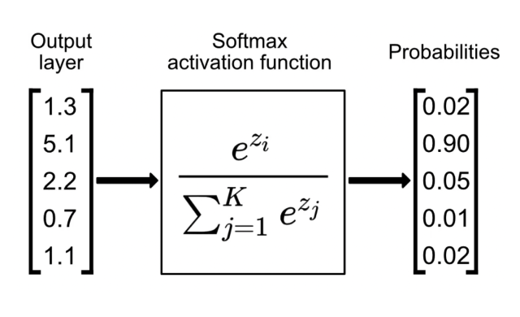
Softmax Function
Notes:
Set the real one equal to 1, all other words 0.

Slide 20
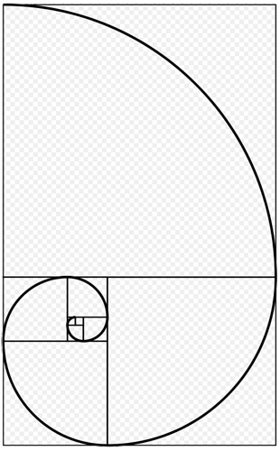
Issues With RNN
As we get to a given layer, the input of layer two back means less than the layer one back.
Notes:
Note weight reuse here as we back propagate through states
Any reference to a word a few back has to propagate its way through the network via the state.
If our new state has half the influence on the state, then the one before has ¼, then 1/8, etc.

Slide 21
Issues With RNN
Variable timestep spacing
Training must be sequential
Current state must always have the same matrix size
Notes:
Sequential training does not play nice with GPUs/TPUs

Slide 22
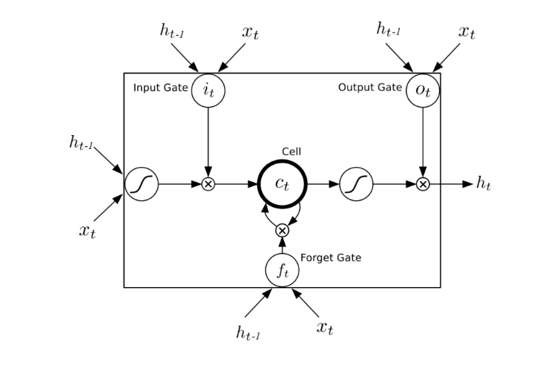
Long Short Term Memory
Notes:
Extension of RNN to include a forget gate, preventing certain data from propagating
Bc of that only critical info makes it thru, so addresses the issue of data being a smaller and smaller piece of the state
Used commonly for most tasks.

Slide 23
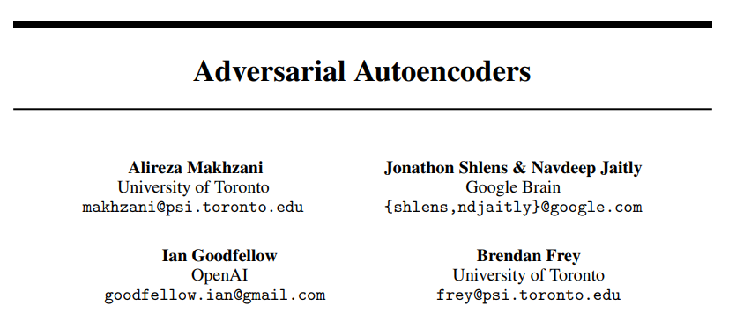
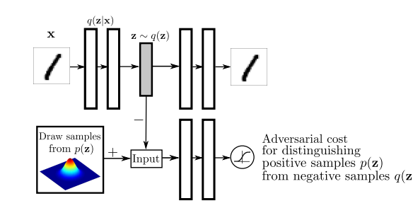
Aside: How to interpret networks in papers
Notes:
Just skip to the picture

Slide 24
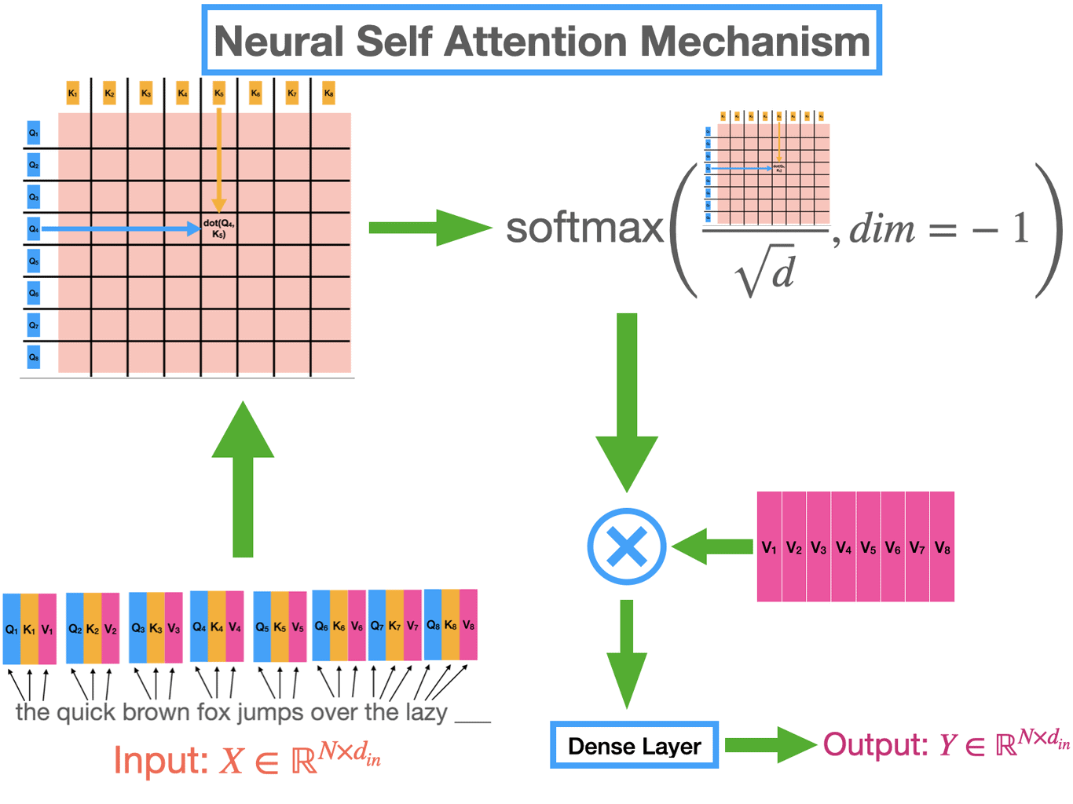

In a few lectures…

Slide 25
Problem Statement
Learn only the critical information needed to represent data
Why do this?
Remove noise
Simplify to human-interpretable patterns
Identify critical genes/labs/imaging features that are distinguish example

Slide 26
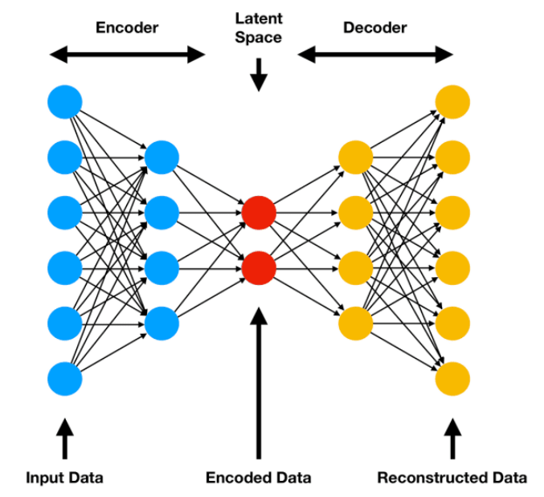
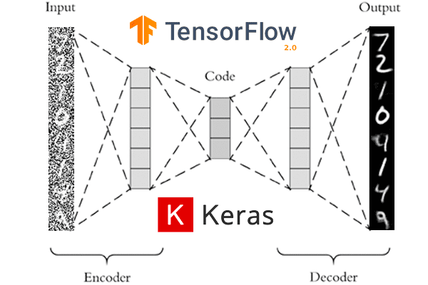
Autoencoders
Notes:
Train network to recover data after pushing through a small bottleneck.
Reconfiguration of the NN structure we all know.
Hyperparaeter is the size of the bottleneck

Slide 27
Autoencoder Considerations
Unsupervised method: Each input is its own expected output
Tradeoff between bottleneck size and reconstruction fidelity
Notes:
Bottleneck size audience participation

Slide 28
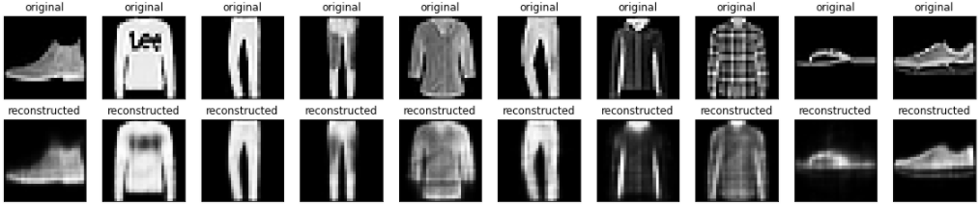
Autoencoder Examples
Notes:
We kept the key info. We lost the text, the shoelaces, but kept the shape.
For training, we add noise. How much we add is a hyperparameter.

Slide 29
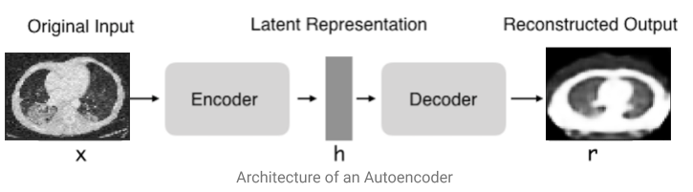
Autoencoder Examples
Notes:
We kept the key info. We lost the text, the shoelaces, but kept the shape.

Slide 30
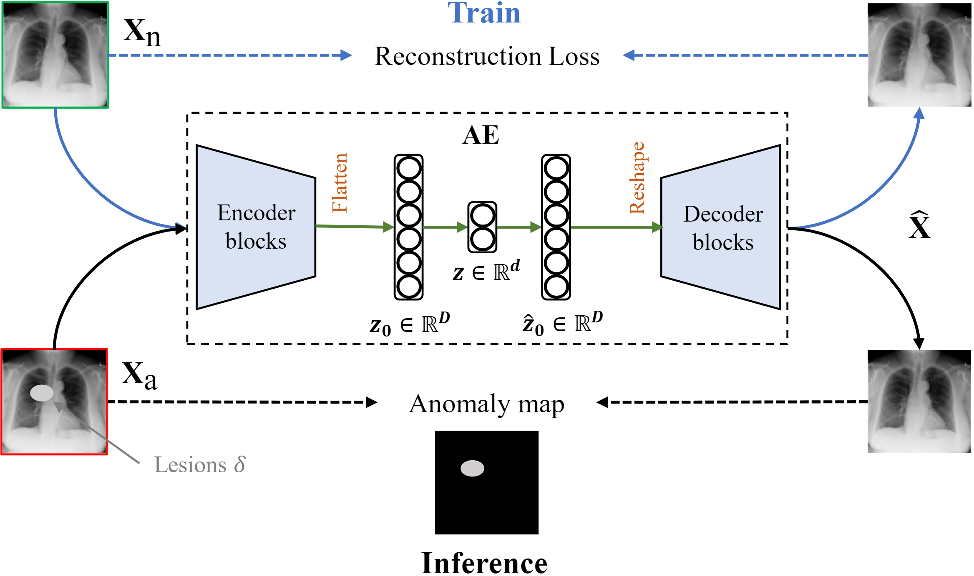
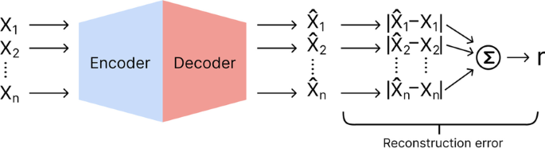
Autoencoder Loss
Notes:
Compare element wise, subtract difference,

Slide 31
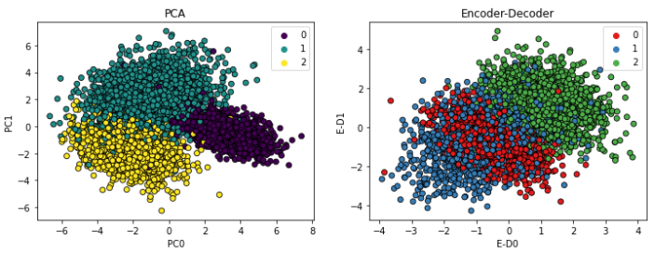
Autoencoders vs Principal Component Analysis
Notes:
PCA is a way to find the key information that separates disparate data points. It converts data that’s many dimensional into 2d or lower d so humans can see key groupings.
For autoencoder, this would be like if you plotted the data at the bottleneck.

Slide 32
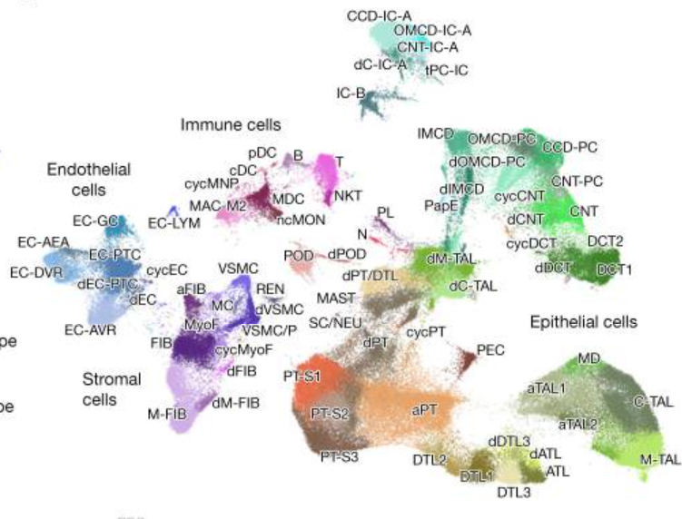
PCA

Slide 33
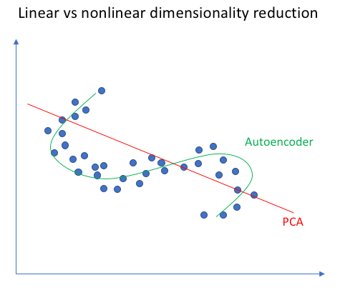
Autoencoders vs Principal Component Analysis
Notes:
In fact PCA is a subset of autoencoders, where the activations are linear (i.e. only constant multiplication)

Slide 34
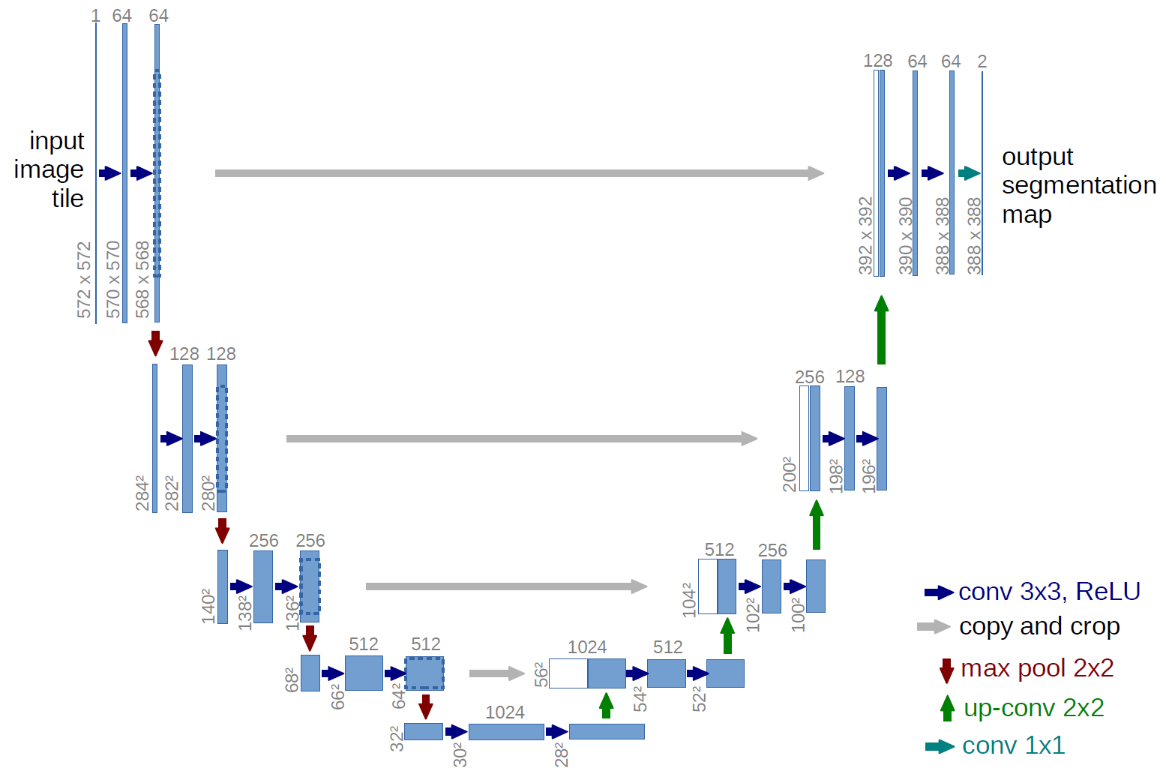
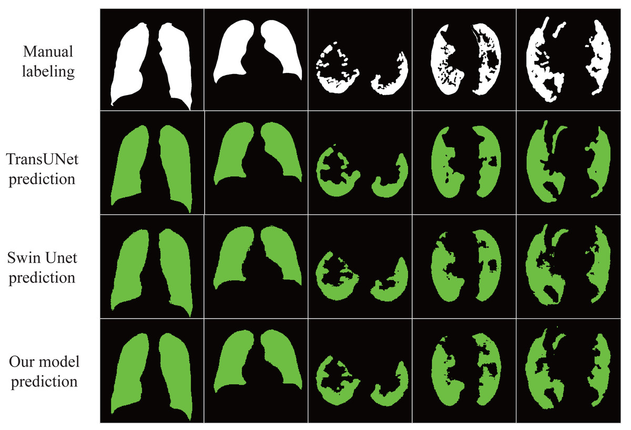
Soon…

Slide 35
Problem Statement
We have tons of patient data, but it’s not private
How can we generate data that clinically similar, doesn’t lose key info, but is changed in a way that prevents tracing back?
OR
How do we generate a new antibiotic that is structurally different from an existing one, but works the same?
Notes:
Fundamentally we’re asking how do we introduce some noise into our signal, then get rid of the noise that wouldn’t randomly be there between two members of the same group

Slide 36
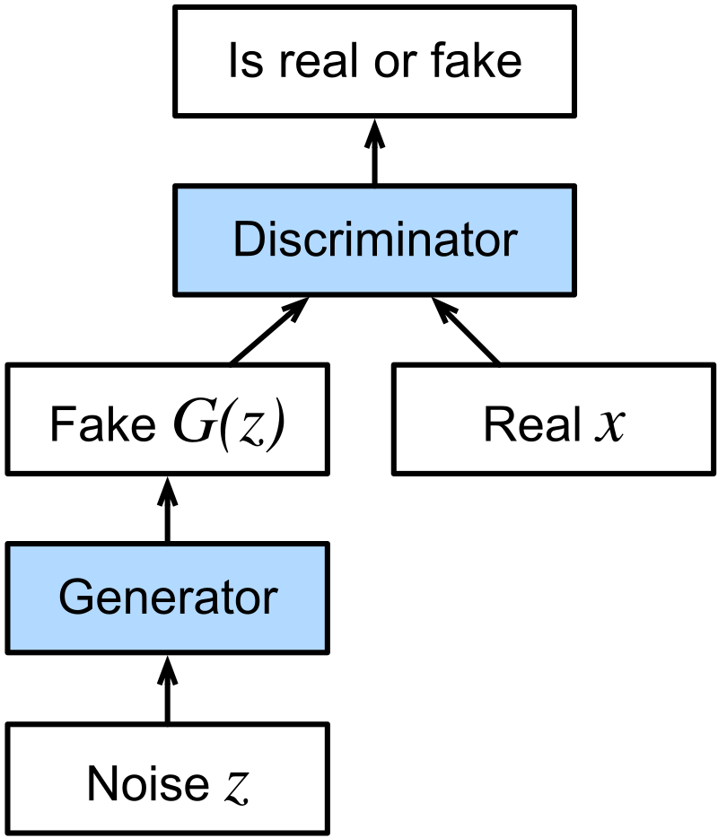
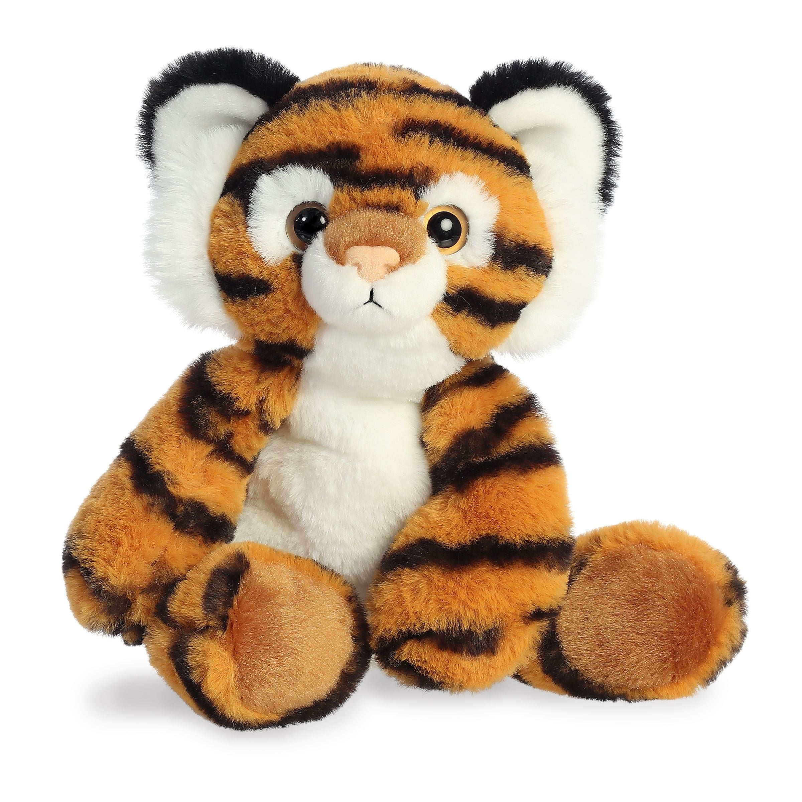
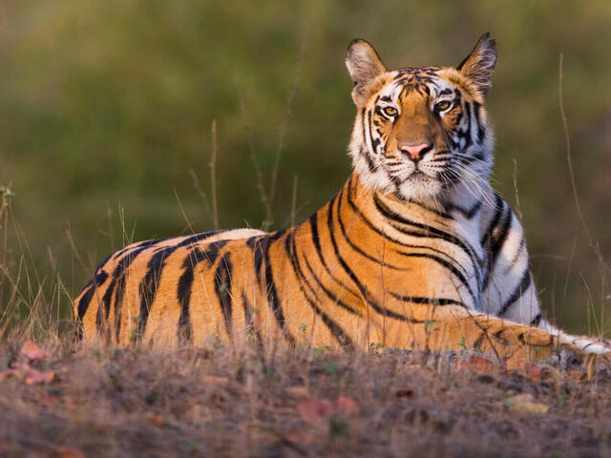
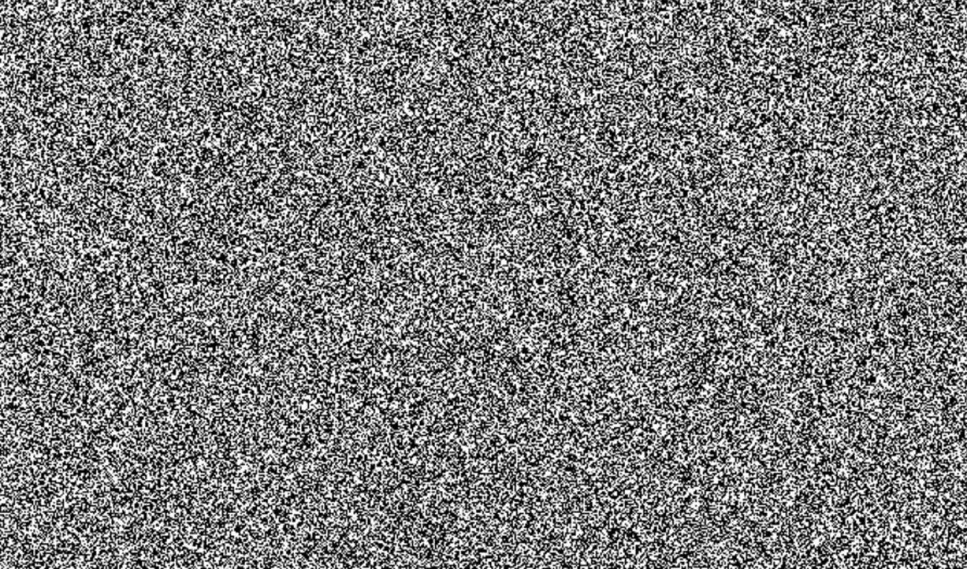
GAN
Real
Fake
Discriminator
Generator
Training data

Slide 37
GANs
General Problem Statement
Technical Problem Statement
Data | Loss
Network | Training
Generate new data that’s indistinguishable from other data
Adversarial binary classification
Any group of similar data,
Sample one at a time (stochastic)
Binary log loss for both
D wants to classify correctly
G wants to fool D
As on last slide
Take turns updating weights for both G and D
Notes:
D wants: $D\left(x\right)=1$for real, $D\left(G\left(z\right)\right)=0$for fake.
G wants: $D\left(G\left(z\right)\right)=1$(fool D).

Slide 38
Mode Collapse
Error in any generative AI network
When generated data too highly represents one class
Dashes in ChatGPT
Always predicting negative on chest x-ray
Common when AI is trained on AI generated data
Tradeoff between quality and diversity
Regularize!
Hyperparameters
Notes:
Hyperparameters can control the variability in the predictions. Won’t go into them here.

Slide 39
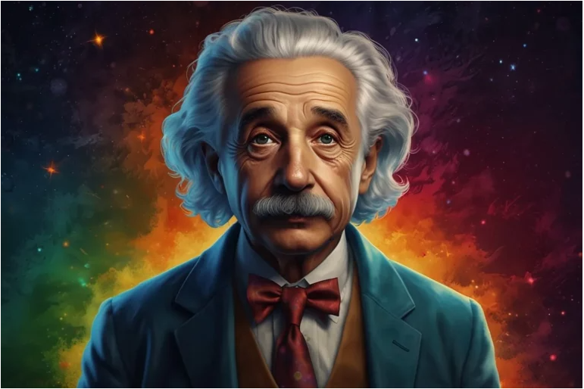
AI Generated Images
Notes:
Ethical concerns

Slide 40
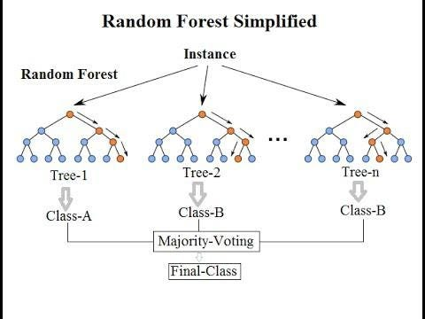
Random Tree
Not a true neural net model
Often used in medicine because interpretable
Plan:
Take a bootstrapped data sample
Find a matrix operation to split the data in half
Repeat until you have the amount of classes you want to predict
For a new example, go down the tree and get filtered into a class
Notes:
Bootstrapping, ensembling technique
Repeat

Slide 41
Random Forest

Slide 42
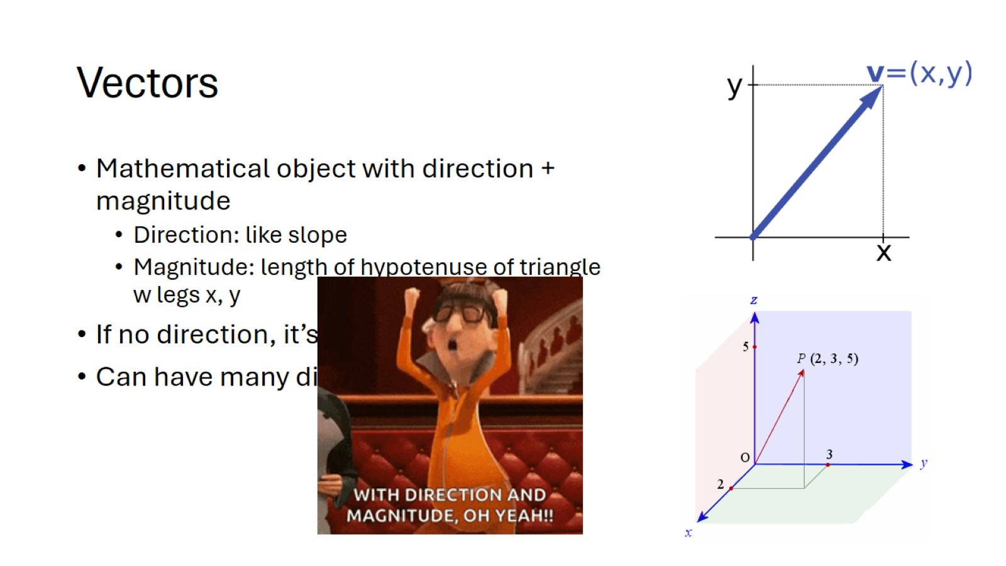
We’ve come a long way!

Slide 43
Thanks!
Notes:
Next lecture all case studies

